Slide 1
Real Estate Forecasting
With Time-Series Modeling
Jhonathan Shaikh

Slide 2
Introduction
Overview

Slide 3
Overview
Data Set
Market Scope
Business Objective
Home Prices
-Zillow.csv
-US 1996-2018
USA 1 Market Area
= Connecticut
Forecast Best Return on Investment Best ZIP Codes

Slide 4
Data Set
Scope

Slide 5
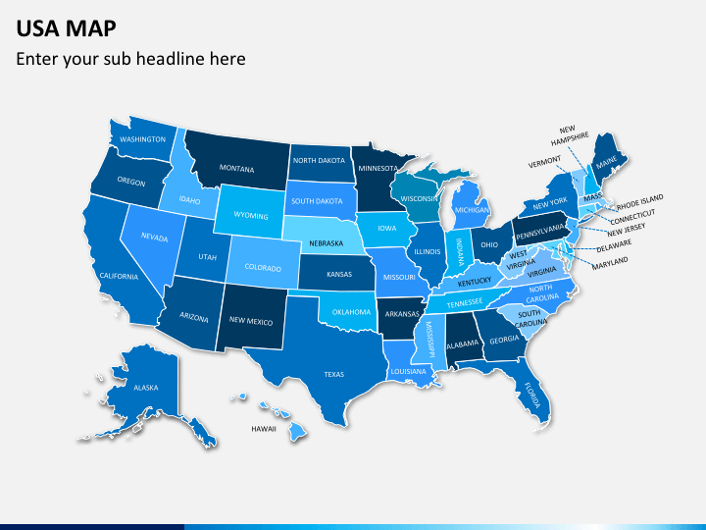
Market Scope
USA
14,253 ZIP Codes
Mercury is the smallest planet
CT
124
ZIP Codes

Slide 6
Market
Focus Key Facts

Slide 7
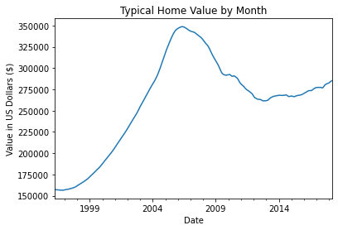
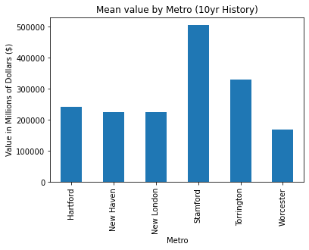
Data Set Key Facts for Analysis
1) 1996-2018
2) US 2008
3) CT 2008-2018
Best Areas
Typical Home Value Declines
21%

Slide 8
Business Results
Forecasting ROI

Slide 9
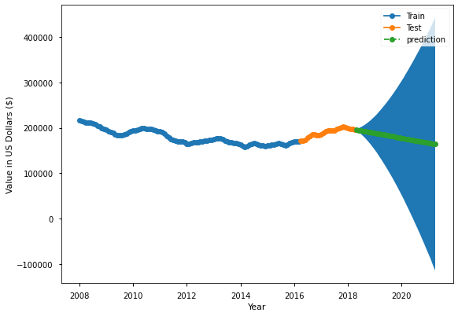
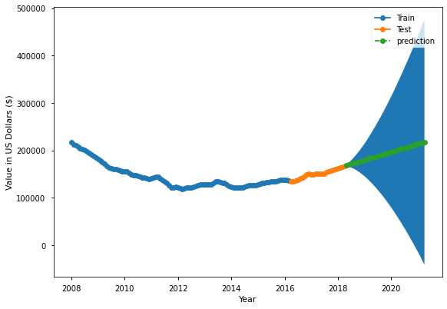
Modeling Results Forecasting ZIP Codes ROI
Bad
Good
Downward Predictive Trend
Upward Predictive Trend
Jupiter is a gas giant and the biggest planet in the Solar System

Slide 10
Targeted ZIP Codes: Highest Projected ROI
6610
31%
6069
24%
6330
21%
6039
19%
6058
19%

Slide 11
Conclusion & Next Steps

Slide 12
Conclusions & Next Steps
EDA Data Set
Data Set
1
We can expand our Modeling Forecasting into more markets in the near future should you want to hire our services
Market
Out of 14,252 ZIP Codes we focuses in CT market with 124
2
We provided the modeling result forecast on 5 Zip Codes
ROI
3

Slide 13
Thank you!! Hire us Again!!

